Slide 1
Brain Game
(Nervous System Activity)
Created by Dr. Andrea Kunze

Slide 2
Setup For Nervous System Workshop
Sit at one of the groups (max 4 per table) and take your laptop (you’ll need at least 2)
Your group will aim to spend about 15-20 minutes to complete each station
Brain Game (Scavenger Hunt & Crosswords) - you will need a laptop
Mouse Party (Simulation) - you will need a laptop
Playing Doctor (Case Studies) - you will need to integrate info from a & b to solve
Work together with your group to fill out the worksheets, discuss the reflection questions, and integrate information to solve some medical cases

Slide 3
Workstation Instructions (Aim for about 15min each)
Step 1: Brain Game
Grab a crossword worksheet
Work together with your group to identify and the correct terms
Access the brain model link (http://www.g2conline.org/3dbrain/) and use the model info to help you find terms
Step 2: Mouse Party
Everyone grab a Mouse Party worksheet
Access the Mouse Party simulation
Work through the simulation & worksheet
Step 3: Playing Doctor
Grab a list of the brain injury cases
Read and attempt to solve one case at a time
Use the resources from step 1 & 2 to determine each of the following in order:
What part(s) of the brain might be affected
What brain scan to test for the problem
How to treat the problem or pain
Explanation of long-term outcomes
Check each step along the way with the instructor.
Be prepared to submit all worksheets to instructor by end of class

Slide 4
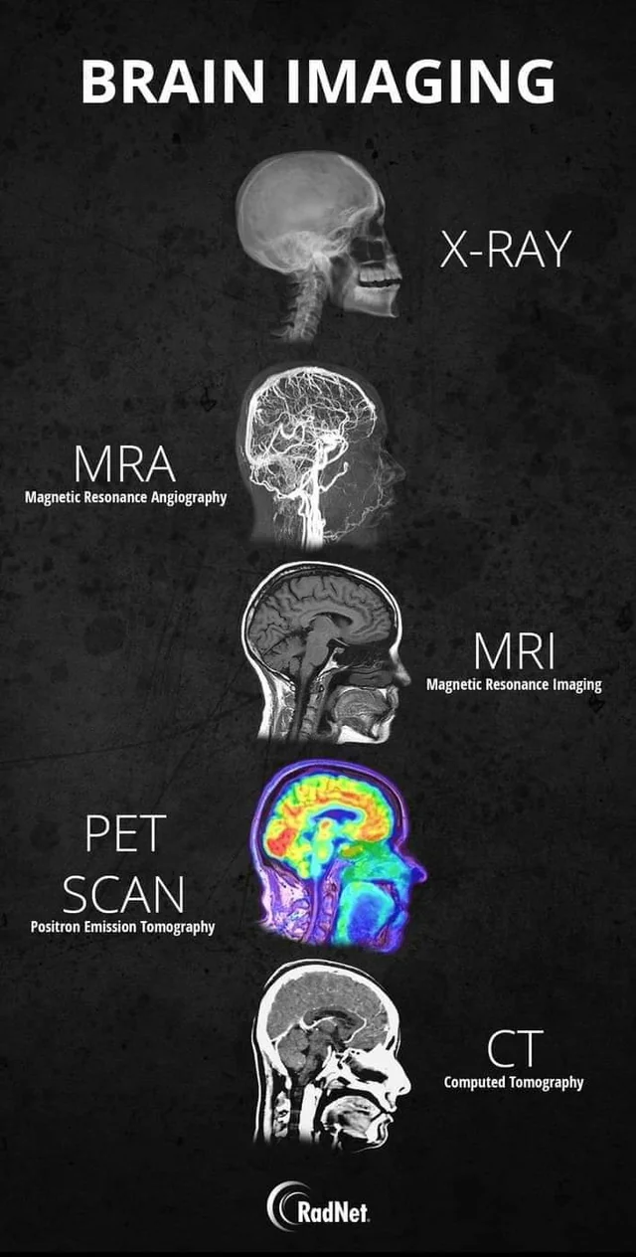
Types & Purposes of Different Brain Scans
X-Ray: shows bone/skull only. Does not show the brain. Best used to detect if there are bone fractures.
CT: a quick test. Shows brain but detail not great. Shows if any larger bleed, stroke, lesions, or masses.
MRI: a long test. Shows brain and detail is great. Shows smaller bleeds, stroke, lesions, or masses.
MRA: shows the flow of blood in the vasculature system of the brain. If there is vessel narrowing or blockage this test would show it.
PET scan: shows how active different parts of the brain is. An active brain uses sugar as energy and pet scan detects how much sugar is being used by lighting up and turning different colors.

Slide 5
Resource Links
3D Brain Model - http://www.g2conline.org/3dbrain/
Crossword puzzle - https://crosswordlabs.com/view/brain-game-51
Mouse Party - https://learn.genetics.utah.edu/content/addiction/mouse/
Mouse Party Worksheet - https://drive.google.com/file/d/1_FswkZWfLqlAgz8Cu3lyMBcJw3A80qw4/view?usp=share_link
Medical Cases - https://docs.google.com/document/d/1Aml_PDjHn93df3CQ0NIjmwQb_XycxaQO/edit?usp=sharing&ouid=116391062822021501009&rtpof=true&sd=true

